Slide 1
Life Is About
Problem Solving
Subscribe @ TravisDaigle.com

Slide 2
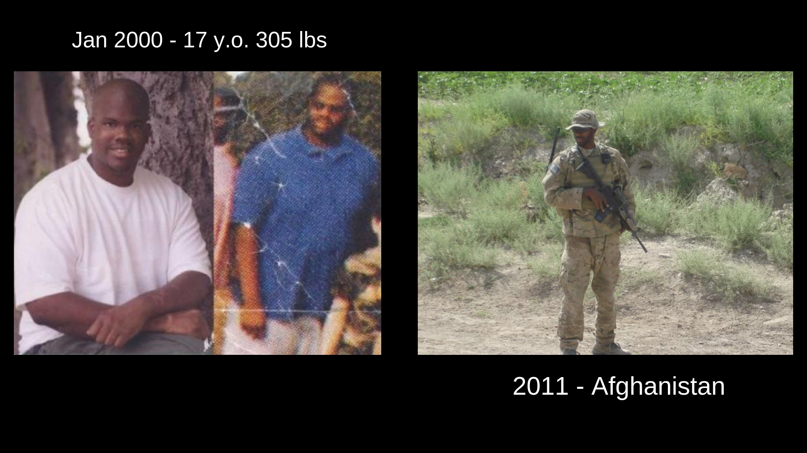
Notes:
Experienced some physical/sexual abuse growing up and dealt with Bullying and teasing due to being very overweight.
Went on to be a first Generation College Grad with an Engineering Degree. Everyone was Happy but me.
Joined the Military in 2007 and Used my past experiences to become a US Army Green Beret.
I used to focus on the character traits but the difficulty is that character is not quantifiable, it’s subjective, and seems to be symptomatic of a process.
In trying to help others with Personal Growth and Resilience I have learned that my Problem Solving Skills have been what help me overcome certain challenges.

Slide 3
2 Types of Problems
Practical Problems - Tangible Challenges related to your goals and life in general. (Practical)
Story Problems - Intangible Challenges related to your goals and life in general. (Story - Our ideas/assumptions about how life should work - Challenges here are Mental/Emotional)
These Problems are tied together.
Notes:
2 Types of Problems - They are connected
Practical Problems - Exams, Workouts, Financial Goals, Pandemic Related - Measurable/Quantifiable
Story Problems - Anxiety, Insecure, Uncertainty - Difficult t measure but tied to Practical Problems

Slide 4
Response
Having goals will create problems you choose and Life will present problems you don’t choose.
The more confidence you have in your problem solving abilities the less intimidated you will be by potential problems.

Slide 5
Problem Solving Process (Taking Control - Ownership)
What’s the Goal?
  What do I think I want?
What are the Conditions?
  What’s True?
Experiment - Maybe the Goal can be achieved like this…
  Failure - Learning What’s True
  Assessing the Original Goal

Slide 6
True Grit
Character is Nuanced
Self Awareness
Can You Trust Your Instincts?
  Learned Skill
You Have to Define Success for Yourself

Slide 7
2 Big Takeaways
Develop Your Problem Solving Skills in every part of your life: Relationships, Health, Career, Finances etc.
Have the Courage to define Success for yourself and have the Humility to let it collapse.

Slide 8
Subscribe to my Blog @
https://TravisDaigle.com
Developing the Critical Thinking skills to meet any Problem with the Confidence to Adapt and Overcome.

