Slide 1




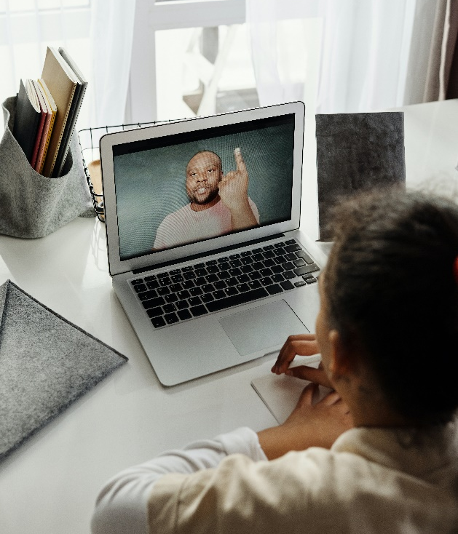



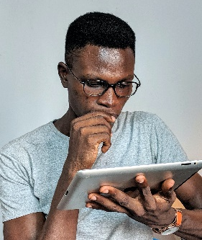

Washington Business Week: Judging Need-to-Know Presentation
Thank you Judges
    Thank you for supporting the “Magic” of Washington Business Week.
    The entire week has been leading up to this moment for our students.

Slide 2
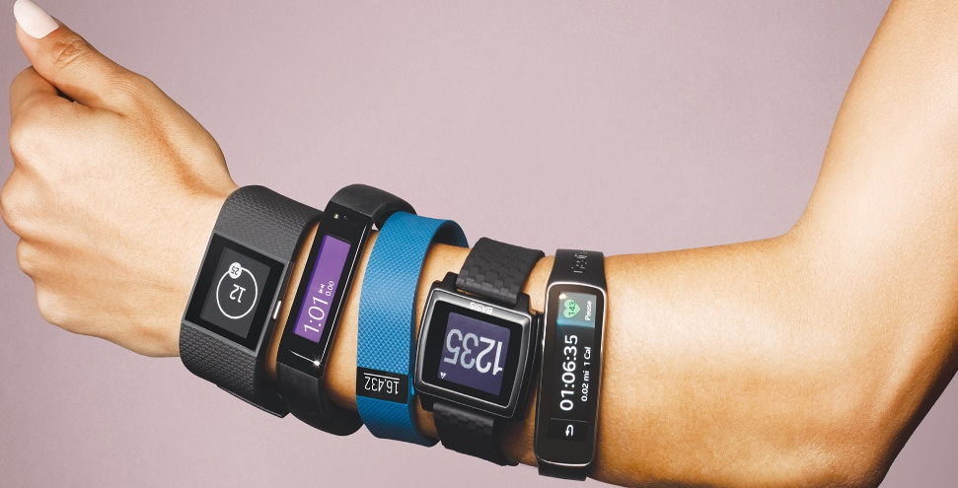
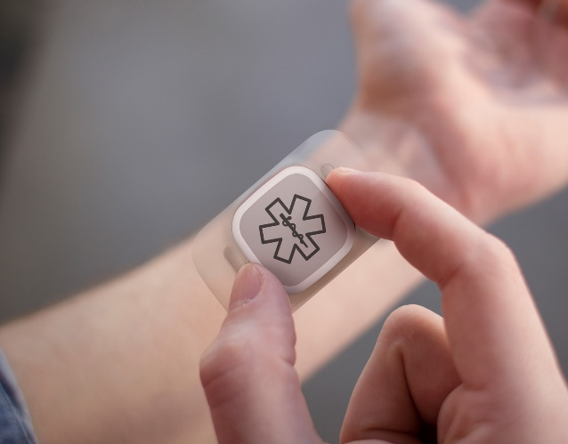

Washington Business Week: Judging Need-to-Know
Stockholders Presentation
  For the past three days, student companies have managed an existing fitness tracker business. They were tasked to be innovative and think outside the box on the product development, production, and the marketing.
  They made quarterly decisions that impacted the company through WBW’s new software, WILE – Washington’s Innovative Learning Environment. They discussed and made decisions on:
  Marketing Production Environmental Human Resources Security Borrowing Pricing Quality Control International Expansion
  Students were challenged to be creative when it comes to fitness trackers – not all of them are watches. We are excited to show you our student innovation.
  Now, they are meeting with you, their shareholders, to report on performance and decisions made during 2 years of operations.

Slide 3
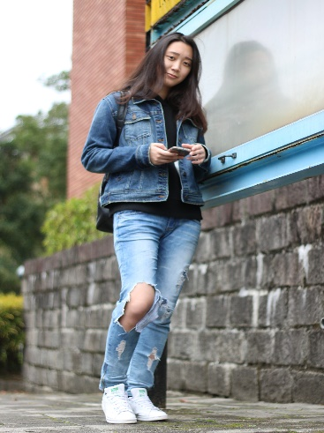




Washington Business Week: Judging Need-to-Know
Stockholders Presentation
Our students should be prepared to answer the following questions:
How did you determine the pricing strategy of your product?
What changes, if any, did you make when you experienced lost sales?
What where the most challenging issues your company faced and why?
What factors (decisions) do you feel had the most effect on your public product perception?
Explain what you think was the driver for both poor and good performance in the various quarters?
How accurate were your predictions over the 8 quarters? How did you use that data and other information to try and improve your forecast in the following quarter?
Did you lay off anyone during the 8 quarters? How did you justify your decision?
Describe the different strengths of your management team.
What was the biggest learning point that your team experienced about managing a business from WILE?
If you could change one decision that you made during the WILE process what would it be and why would you change it?
What challenges did you face working as a remote team in this virtual learning environment?

Slide 4
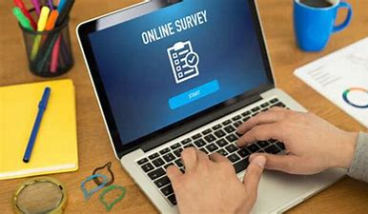
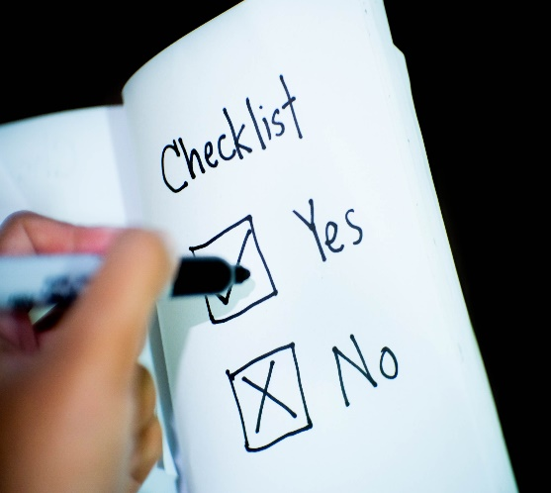

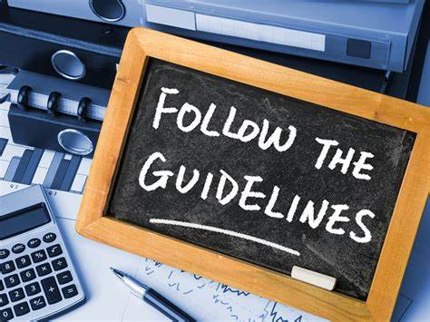
Washington Business Week: Judging Need-to-Know
Stockholders Presentation
  Judging Guidelines
  Familiarize yourself with the judging information – video, questions, and scorecard survey.
  Please limit questions to those provided on the judging sheets. Work with fellow judges in your group to create a flow of question asking.
  Students will enter the judging zoom room where you and your fellow judges are virtually present. Students must maintain a high level of professionality when entering and exiting the virtual room.
  Please fill out the score card survey and submit them as soon as you finish judging all the presentations. WBW has a tight turn around to an awards ceremony. We are awaiting your decisions on the winners so we can make certificates.
  Students have worked hard, and they are nervous. Please be positive when offering constructive criticism.

Slide 5
Washington Business Week: Judging Need-to-Know
Final Callouts
  Students are asked to dress professionally for presentations. Please keep in mind that this means different things to different students.
  Take notes in the margins during presentations so you are better able to go back and adjust scores after you have seen all presentations and are better able to compare teams.
  Please stick to the questions provided as they focus on what is expected from all groups. Different groups may have deeper knowledge in one area, or another based on their Company Advisor. Functional expertise may not be consistent from one group to the next.
  Please make sure to fill out the scorecard surveys and return them ASAP.
  Interested in leading a team of students? You too, can be part of a student team’s journey. There are opportunities this year in June, July, and August or in-person next year on campuses throughout Washington.

Slide 6
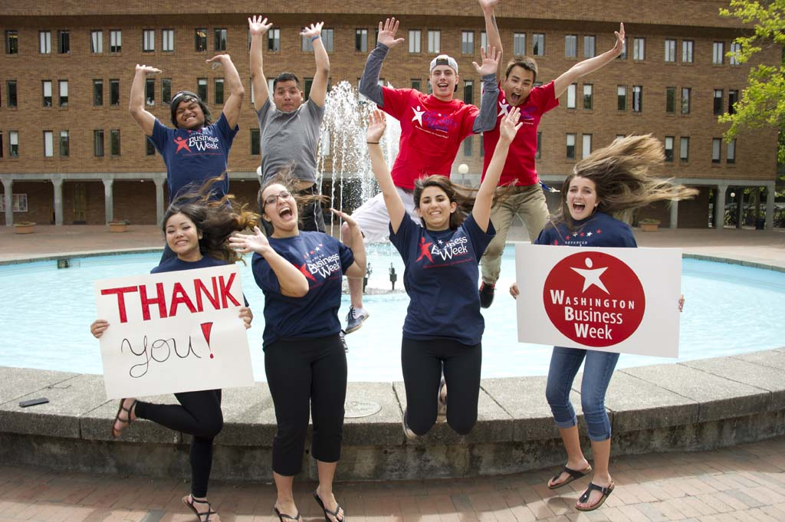
Thank You!

